Slide 1


Network Science and Methods Experiences from infrastructure risk modelling
Dr Raghav Pant
Environmental Change Institute
University of Oxford
ITRC Weekly Meeting
September 9, 2020

Slide 2
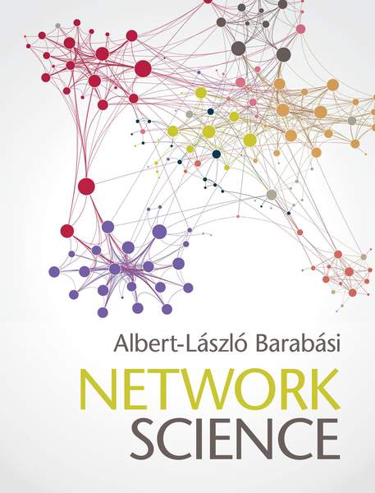

Learning about network science
Building network graph models to study and predict biological, social, physical, technological phenomena
http://networksciencebook.com

Slide 3
Understanding network topology
Graph topology - Collection of nodes and connecting edges
Source: Thacker, S., Hall, J.W. and Pant, R., 2018. Preserving key topological and structural features in the synthesis of multilevel electricity networks for modeling of resilience and risk. Journal of Infrastructure Systems, 24(1), p.04017043.

Slide 4
Understanding network directionality
Source: Pant, R., Russell, T., Zorn C., Oughton, E., and Hall, J.W. (2020). Resilience study research for NIC – Systems analysis of interdependent network vulnerabilities. Environmental Change Institute, Oxford University, UK.

Slide 5
Mapping network path effects
Functional path mapping
Failure propagation mapping
Source: Thacker, S., Pant, R. and Hall, J.W., 2017. System-of-systems formulation and disruption analysis for multi-scale critical national infrastructures. Reliability Engineering & System Safety, 167, pp.30-41.

Slide 6
Representing infrastructure networks
Source: Pant, R., Hall, J.W. and Blainey, S.P., 2016. Vulnerability assessment framework for interdependent critical infrastructures: case-study for Great Britain’s rail network. European Journal of Transport and Infrastructure Research, 16(1).
Source: Pant, R., Russell, T., Zorn C., Oughton, E., and Hall, J.W. (2020). Resilience study research for NIC – Systems analysis of interdependent network vulnerabilities. Environmental Change Institute, Oxford University, UK.

Slide 7
System-of-systems approach
Source: Thacker, S., Pant, R. and Hall, J.W., 2017. System-of-systems formulation and disruption analysis for multi-scale critical national infrastructures. Reliability Engineering & System Safety, 167, pp.30-41.

Slide 8


Useful network analysis tools
Data cleaning
Model development
Analysis
Output generation
Data processing
Visualisations

Slide 9
Properties of networks - Centrality
Network metric/characteristic name | Meaning | Implications on vulnerability
Degree centrality | Number of linkages that a node or edge has. | Provides information on which nodes/edges could physically knock out most of their surrounding network.
Clustering coefficient | Degree to which node triplets of networks cluster together. | Provides information on which groups on nodes would knock out each other.
Closeness centrality | Average length of the shortest path from a node and all other nodes in the graph. Thus, the more central a node is, the closer it is to all other nodes. | Provides information on which nodes/edges could most quickly knock out flows.
Betweenness centrality | The number of times a node/edge acts as a bridge along the shortest path between two other nodes. | Tells us about the how nodes/edges being knocked out could affect network flows.
Eigenvector centrality | Measure of how well connected a node is to other well-connected nodes in the network. | Quick way to accessing the relative contribution of nodes in influencing and spreading failures. High eigen score means a node is connected to other nodes with high connectivity as well. So knocking off high eigen score nodes could knock out other high eigen score nodes as well.
Cross-clique centrality | Determines the connectivity of a node to different completely connected subgraphs (called cliques). | Tells us if a node from one network can knock out all nodes in another. A node with high cross-clique connectivity facilitates the disruption of all nodes in the clique.
1/Trophic coherence* | Describes how neatly the nodes fall into distinct levels in a directed network, in terms of their degrees. A source has a trophic level = 1, which is the lowest but also signifies it has the highest level. | Tells us how different network hierarchies are organised, which could be useful for understanding failures at different levels.
Path centrality | Count of numbers of flow paths mapped through nodes and edges. | Tells us which routes are most significant for network operations.
Core-periphery | Describes a group of central and densely connected nodes and sparsely connected periphery nodes which governs the overall behaviour of a network. | Shows which nodes are most connected to groups of lesser connected nodes in the network. Knocking out such well-connected nodes will knock out most of the network functionality.
* In theory, the nodes with lowest trophic level are considered to be the most important. Hence we take the inverse values to give such nodes the highest ranks

Slide 10
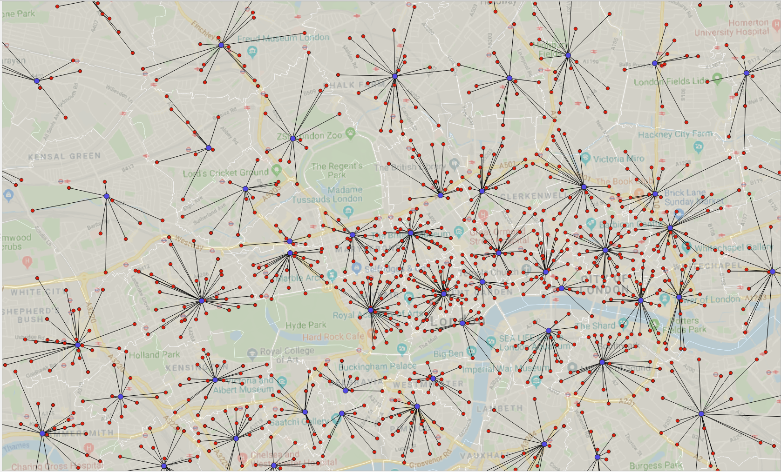
Degree centrality effect – Example Telecoms
Blue dots - Exchange points
Red dots - Macro cells
Black lines – Connecting (dependency edge) from exchange to macro cell

Slide 11
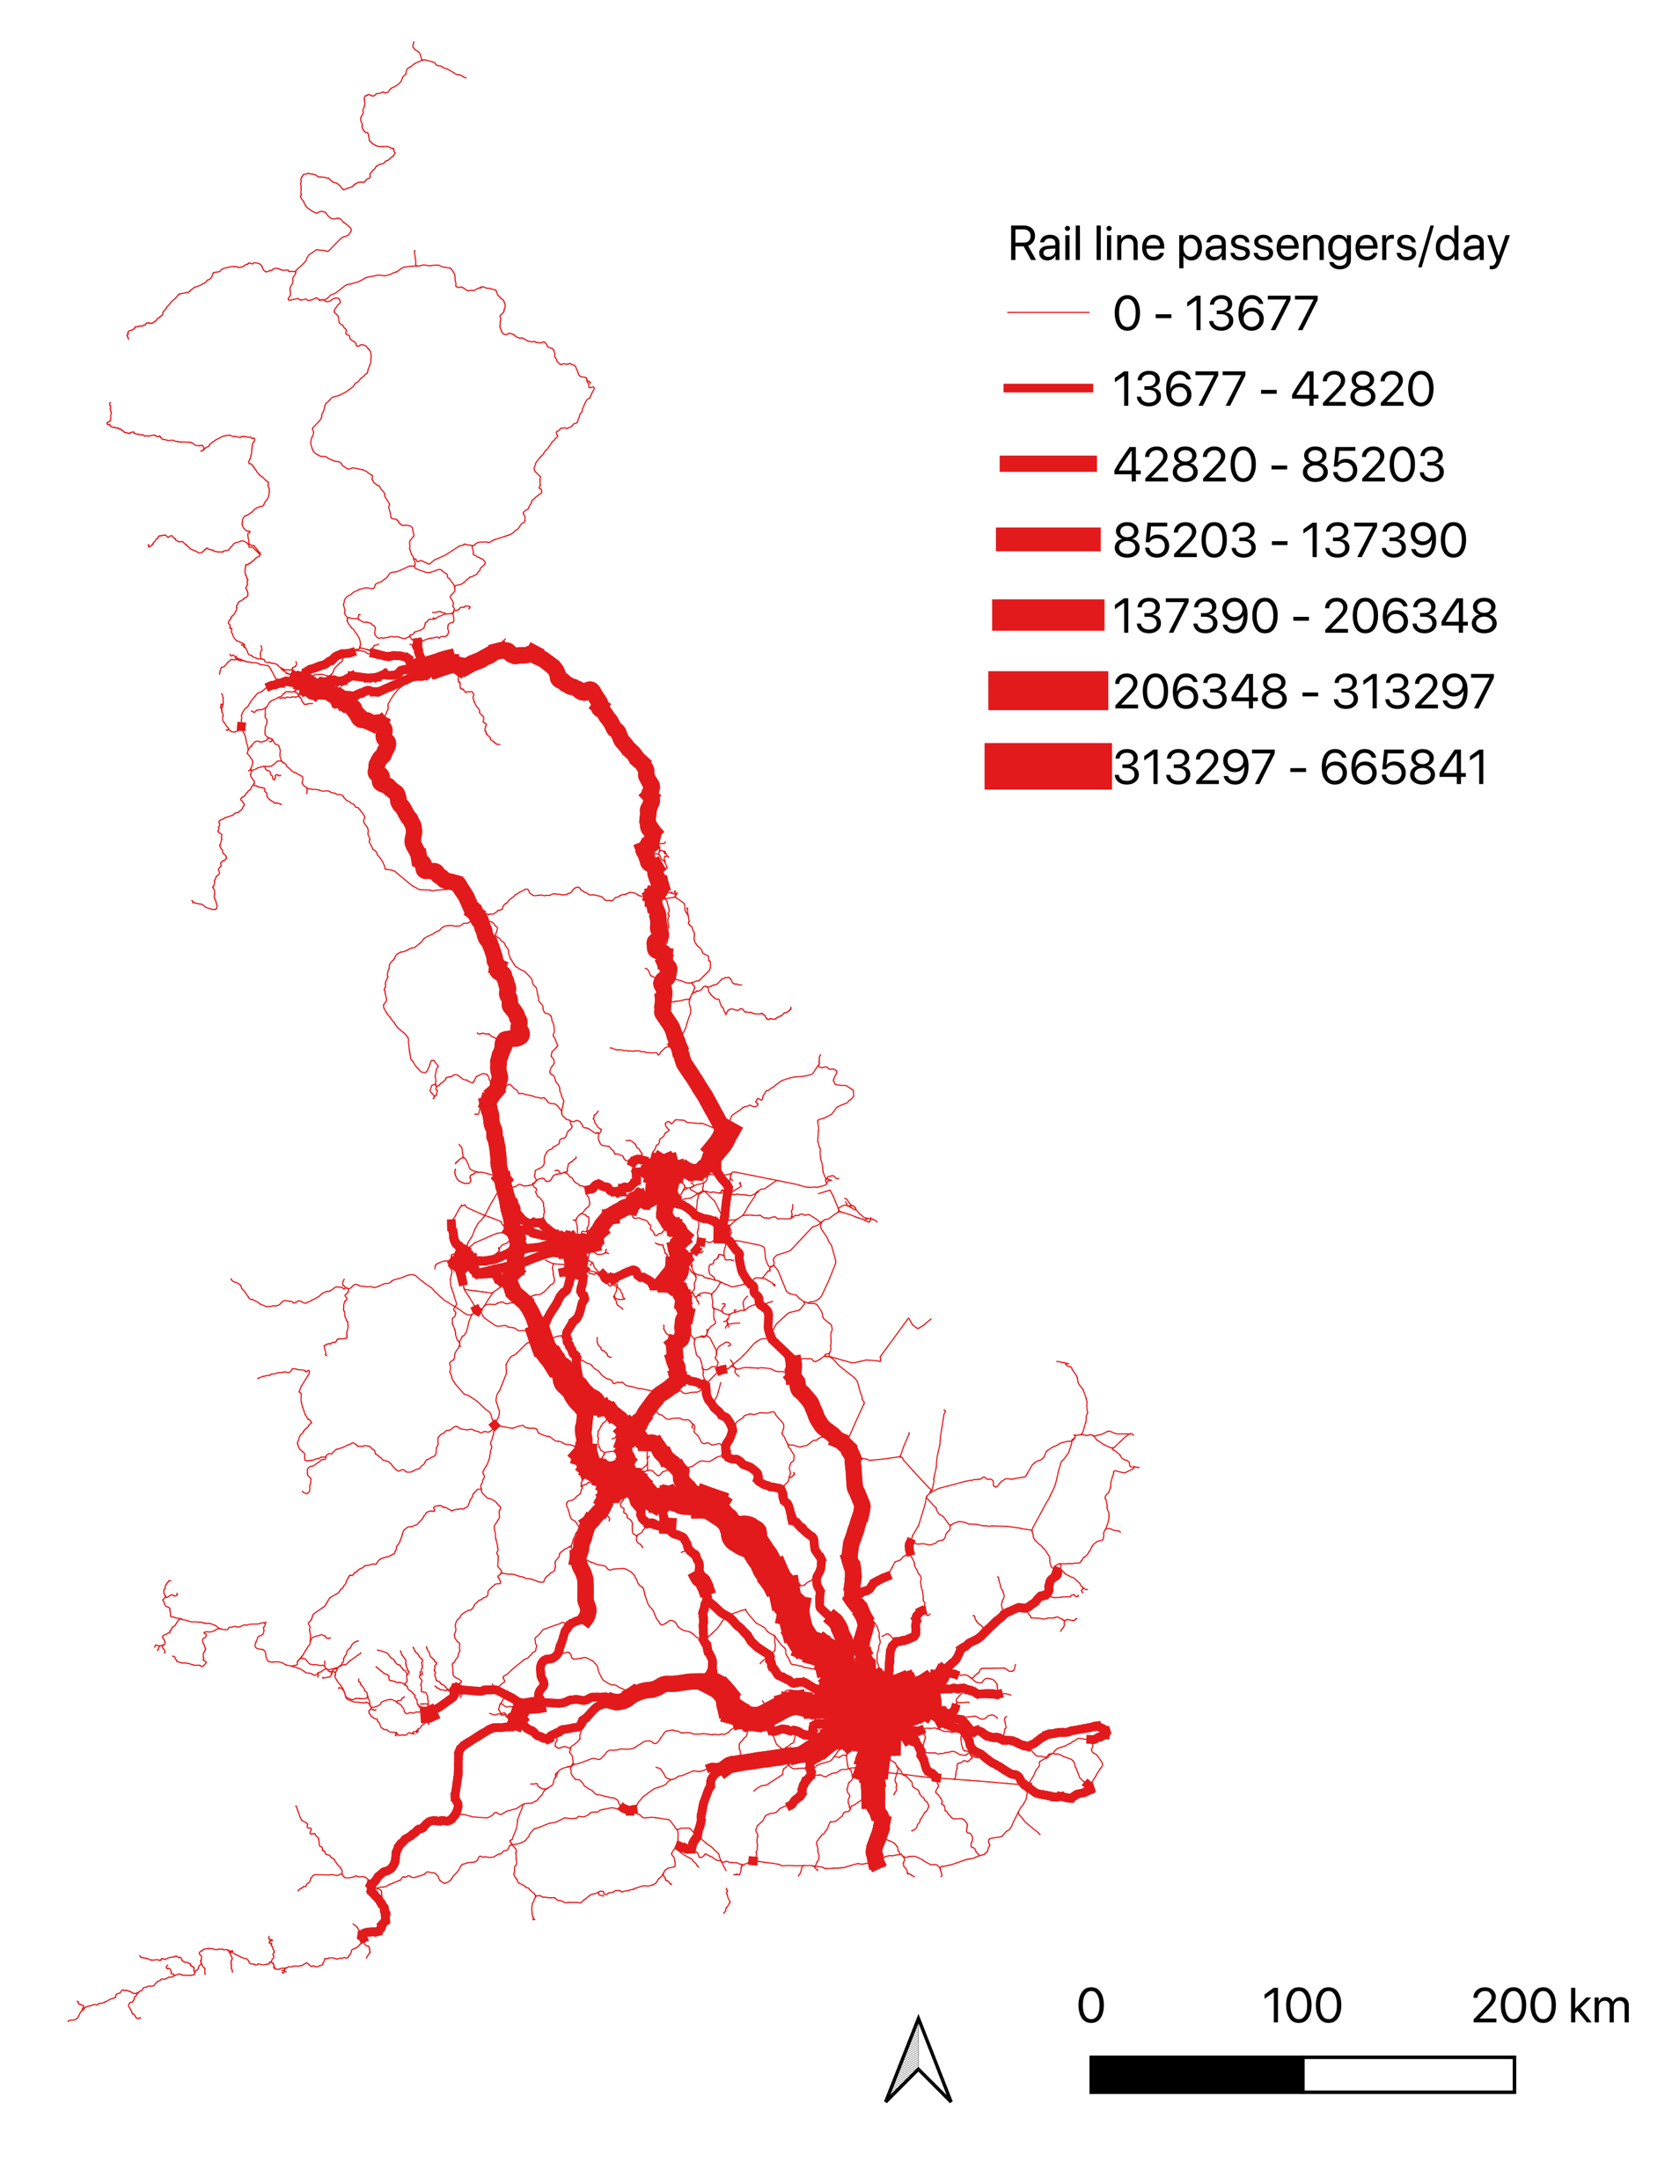
Path centrality effects – Example Transport

Slide 12

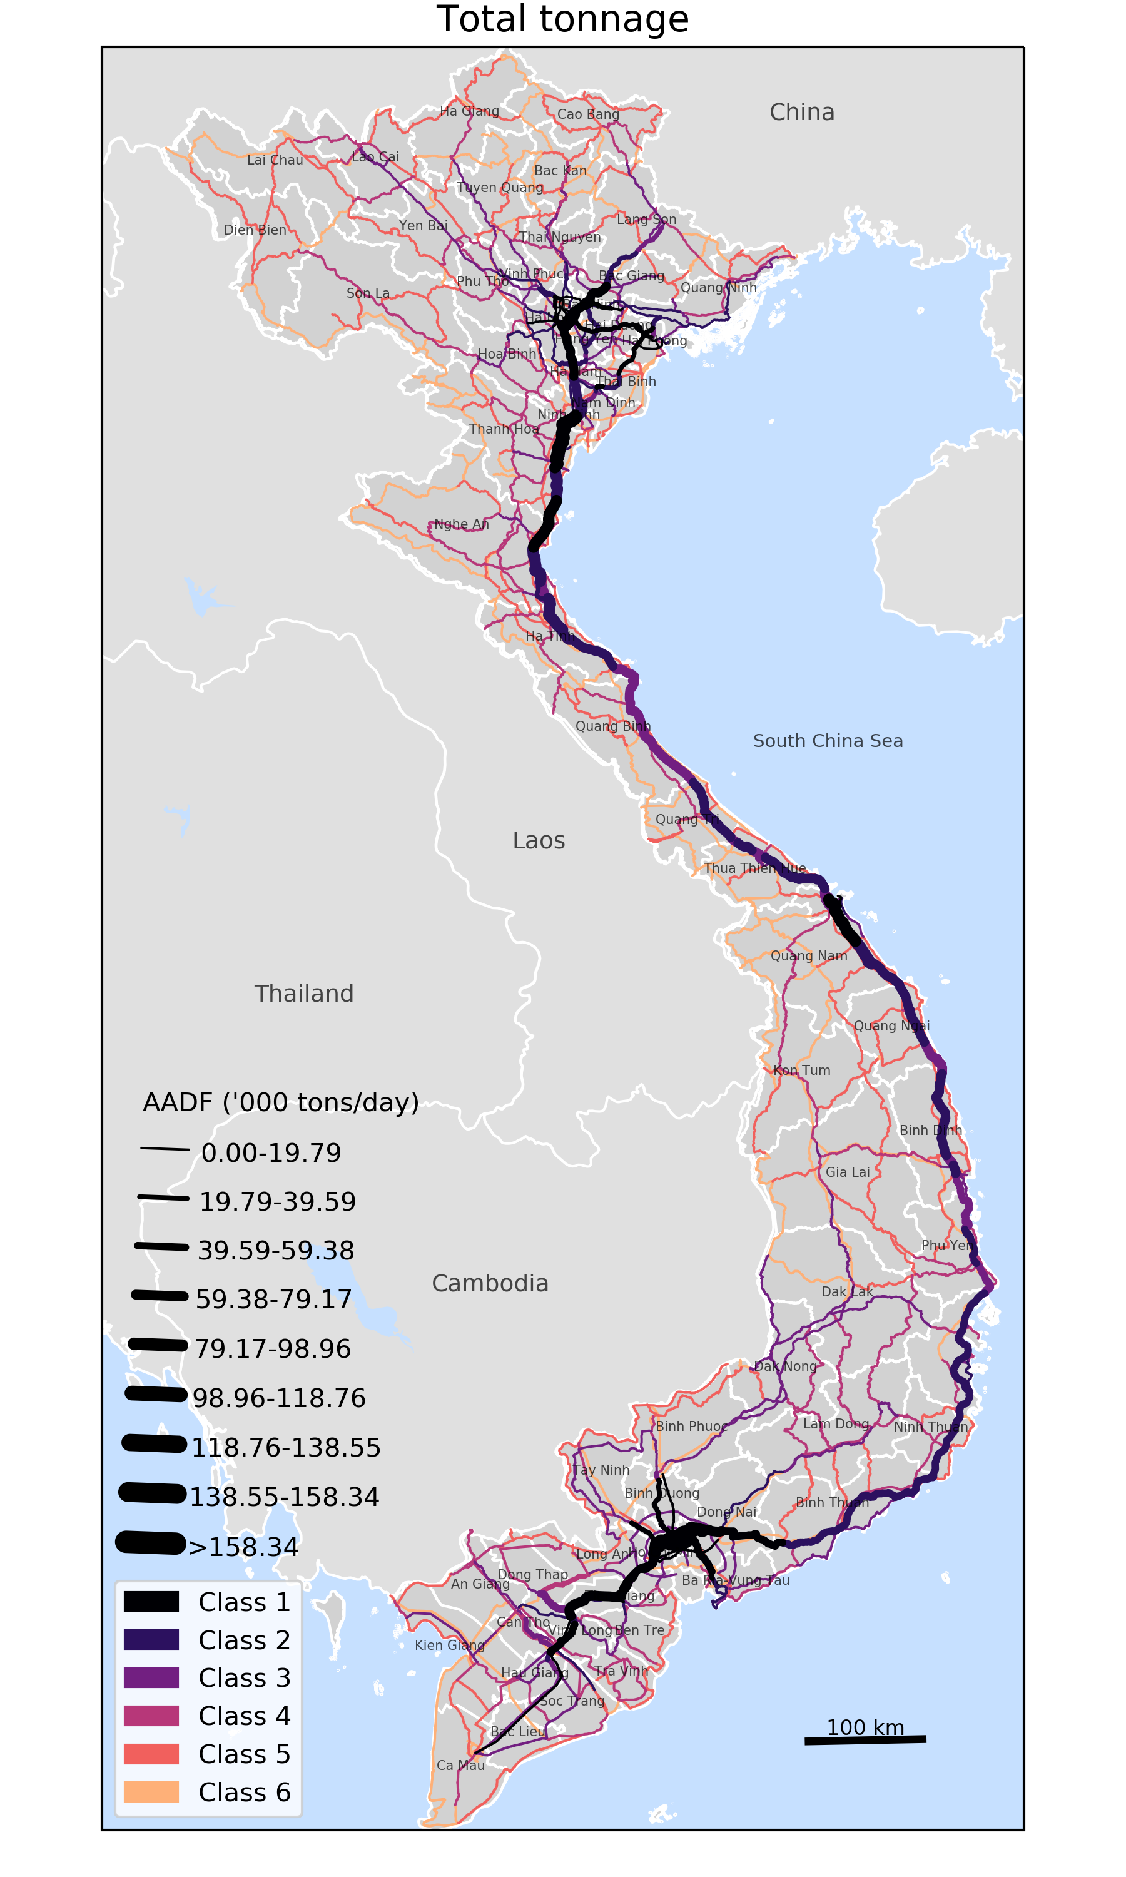
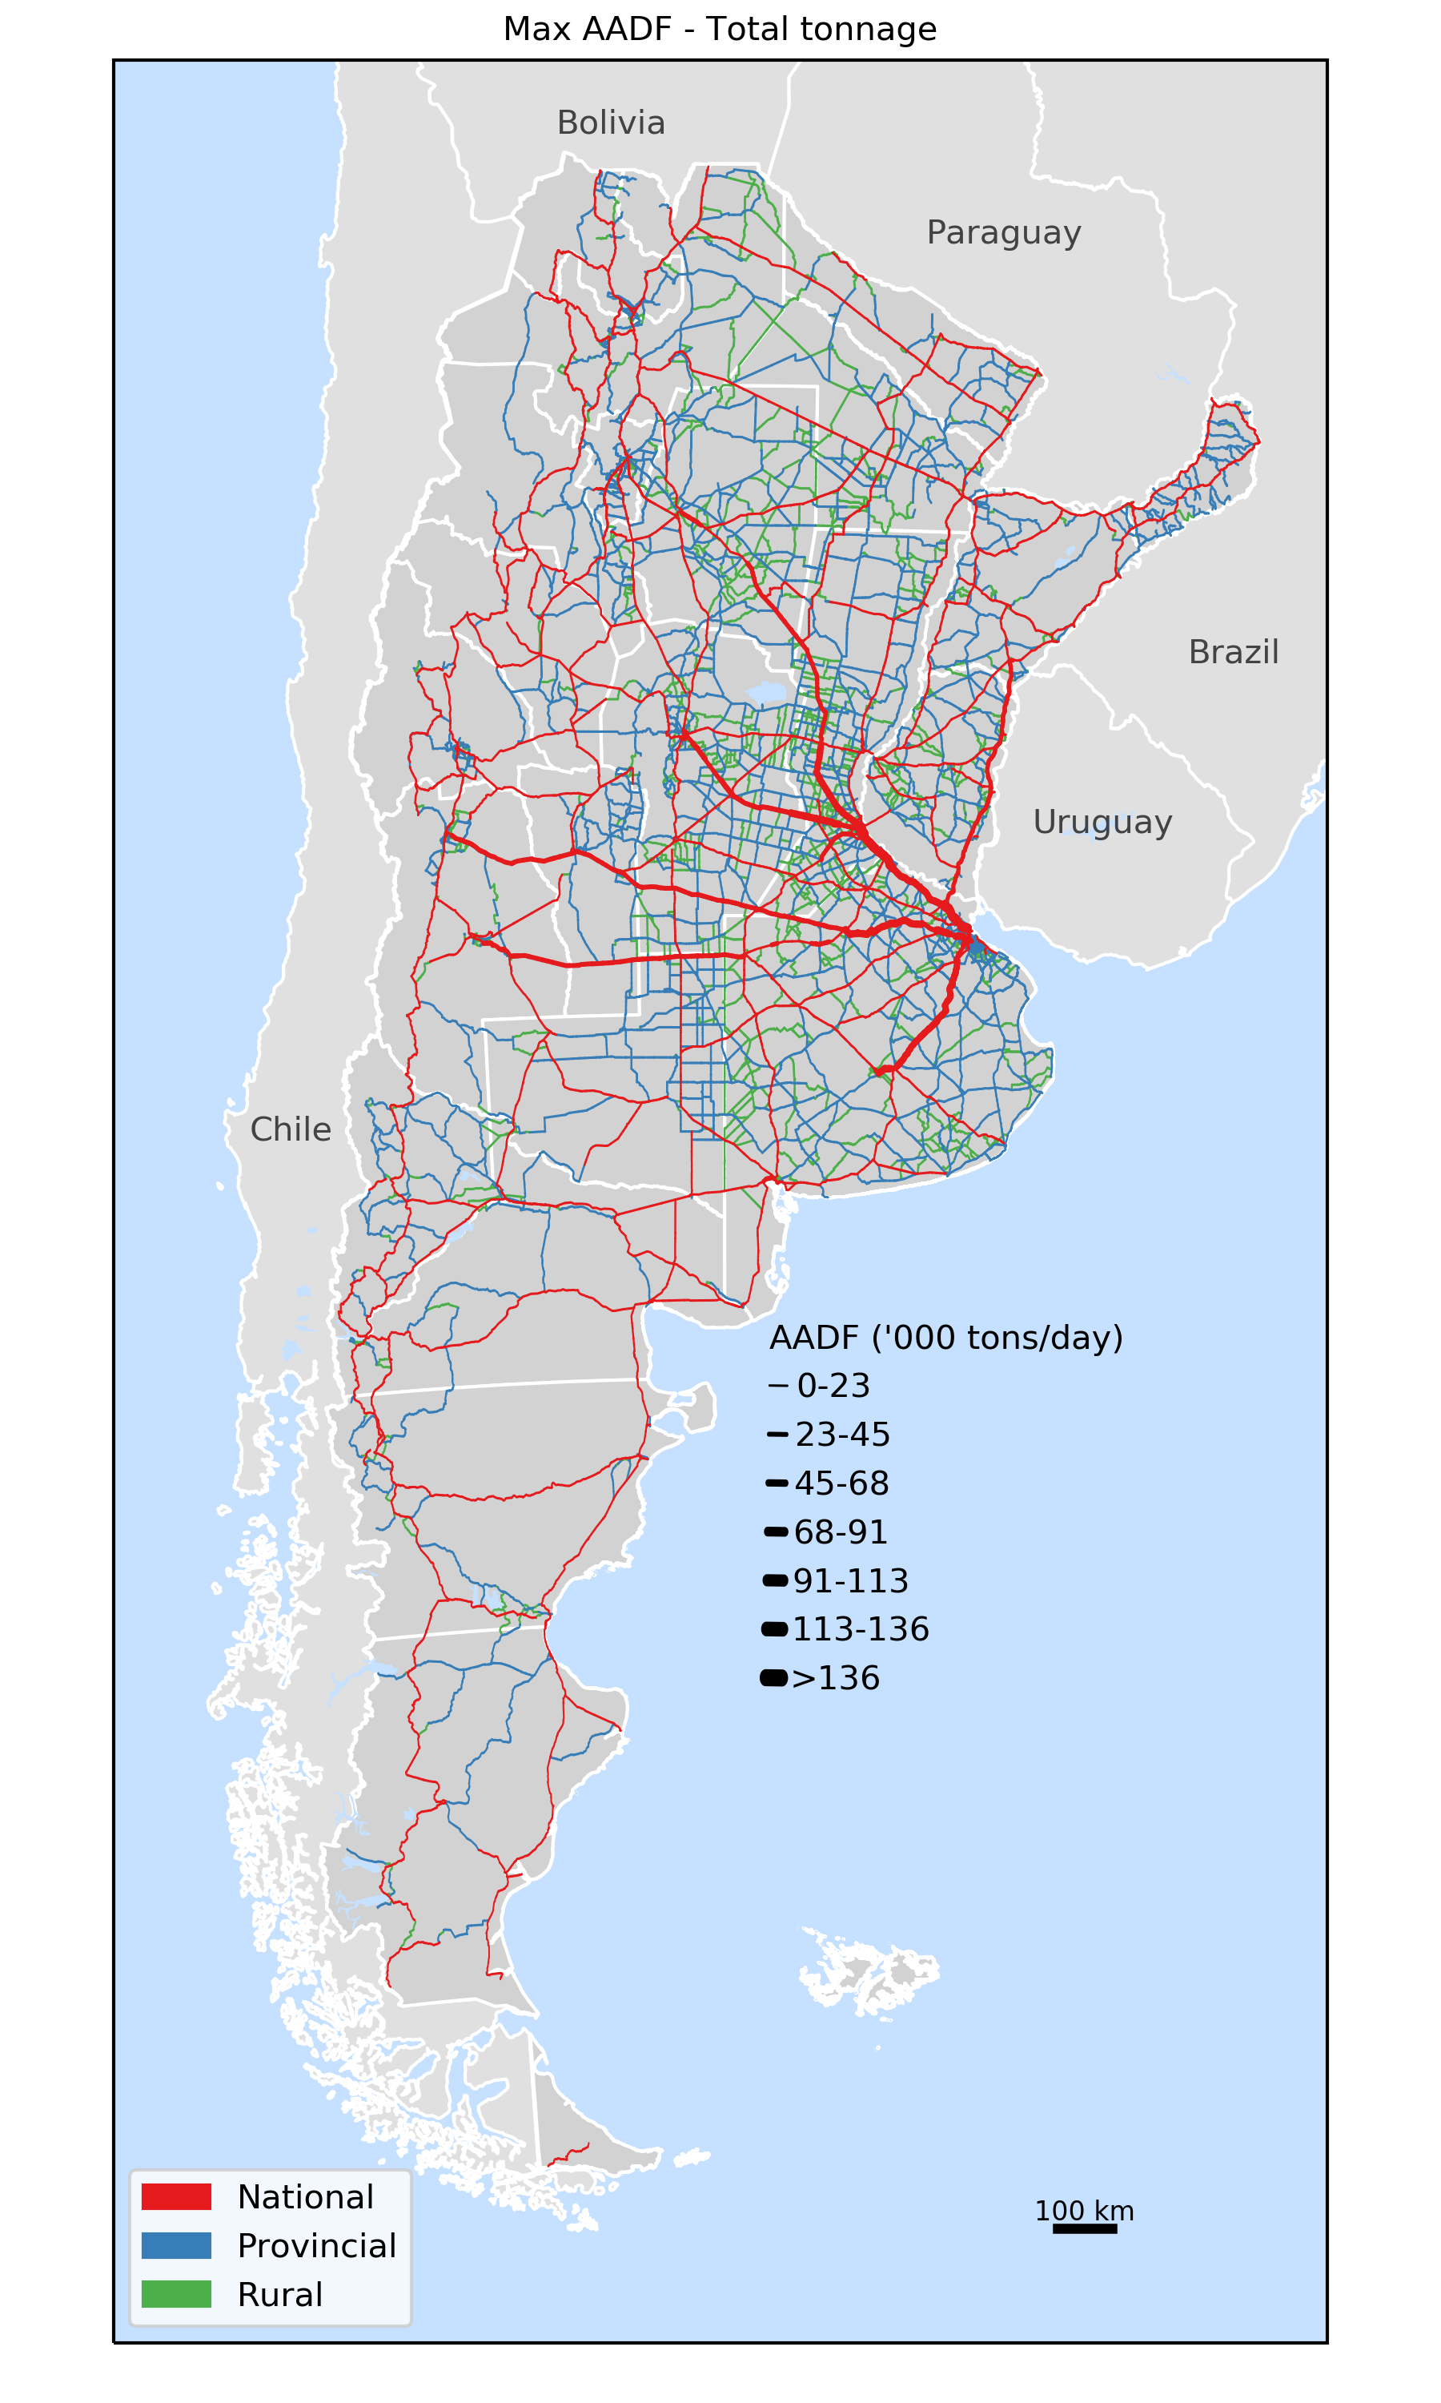
Application: Transport flow mapping
Vietnam
Argentina
Critical links analysis:
Mapping daily freight flows along transport networks in countries to identify key linkages of economic importance
Flows are mapped using shortest path algorithms that give least transport costs

Slide 13
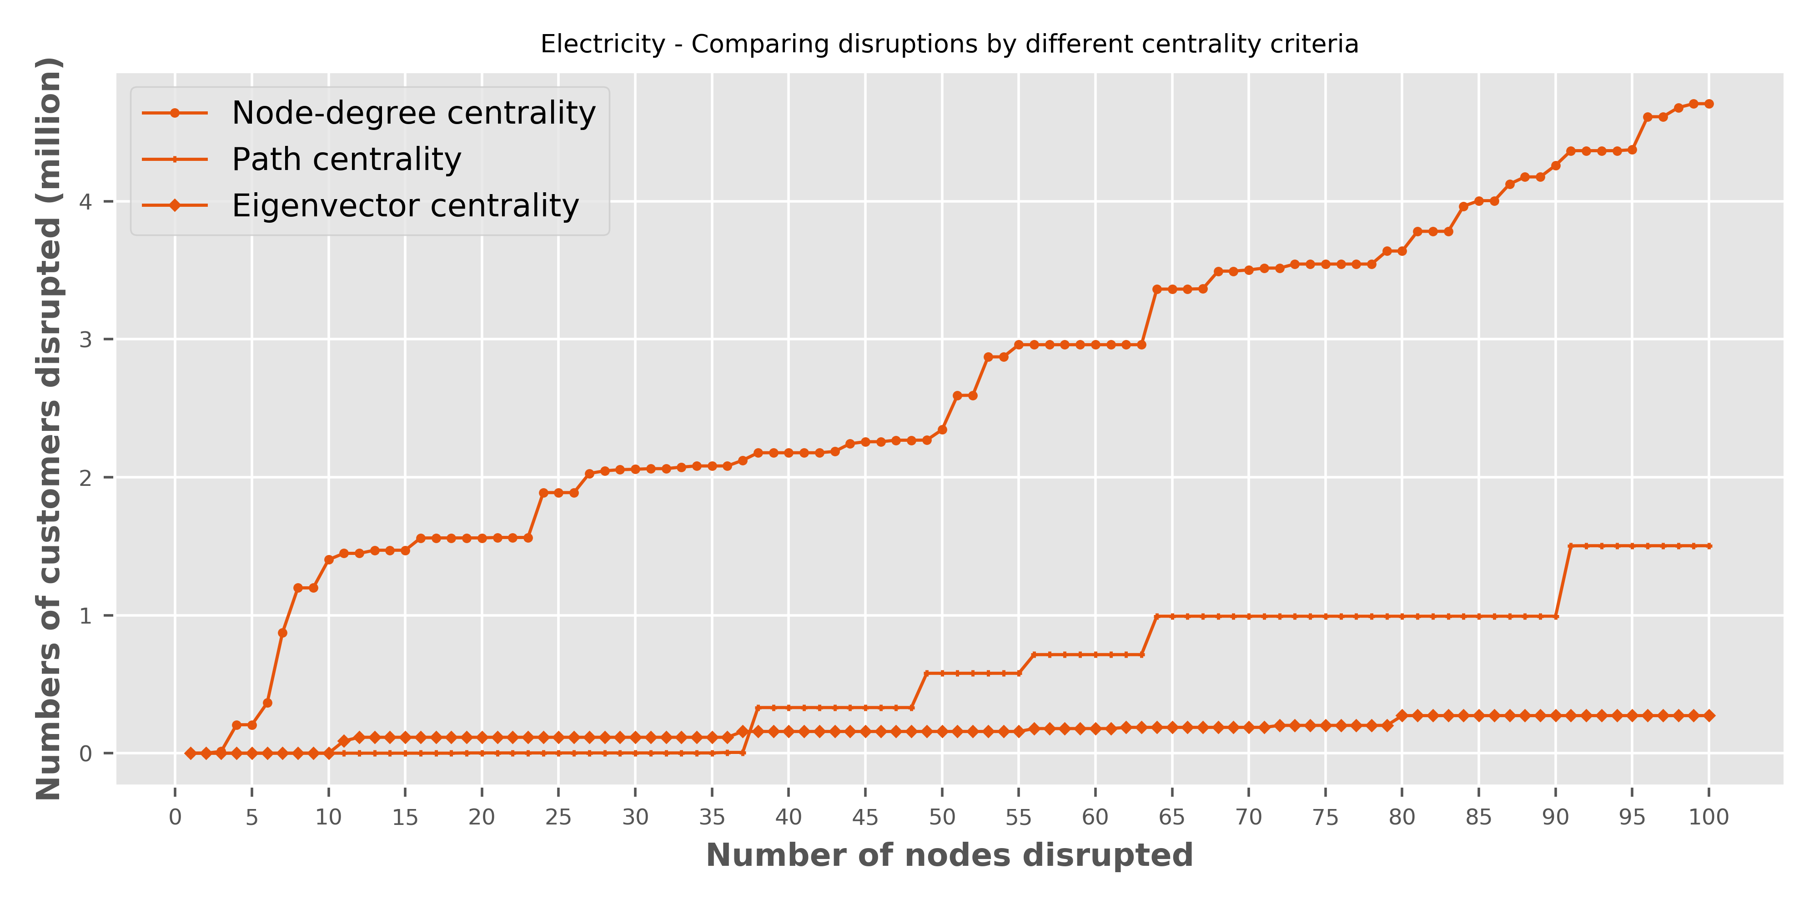
Inferring network robustness from centrality
A
B

Slide 14
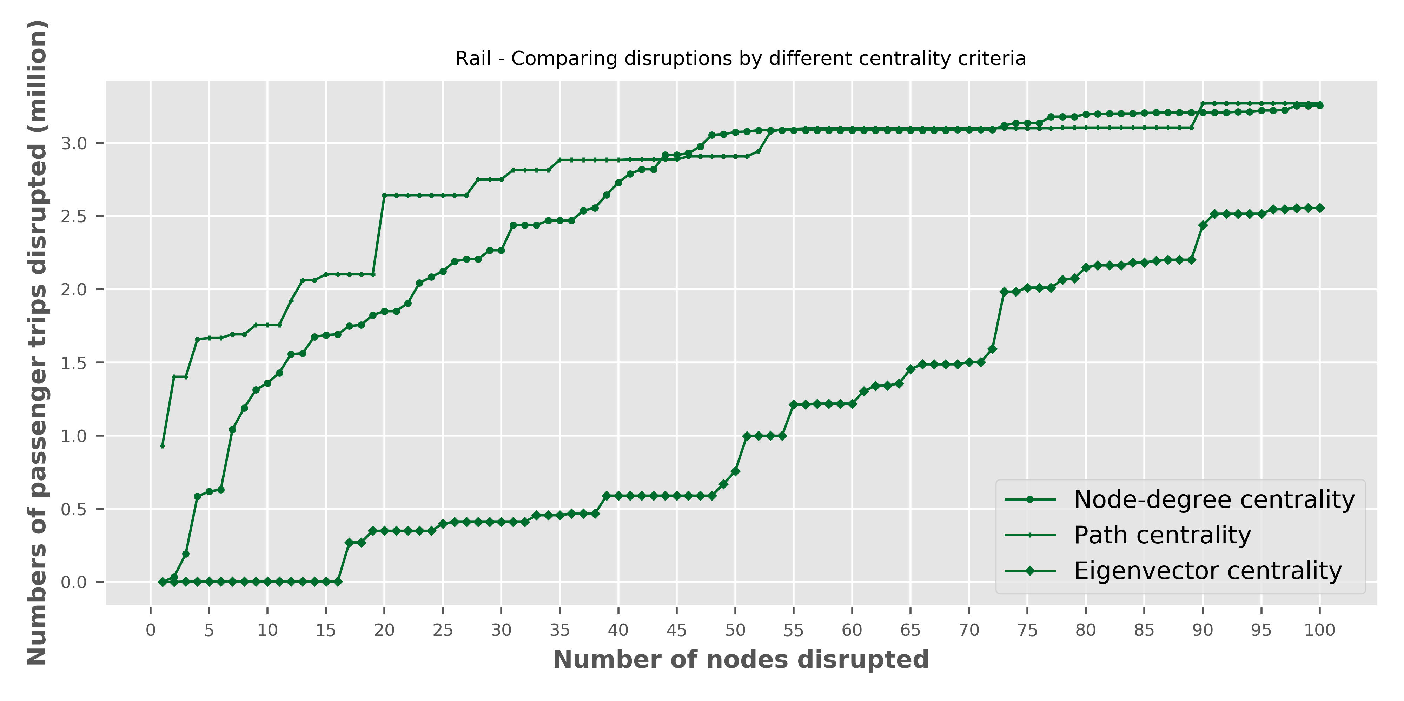
Inferring network robustness from centrality
B
A

Slide 15
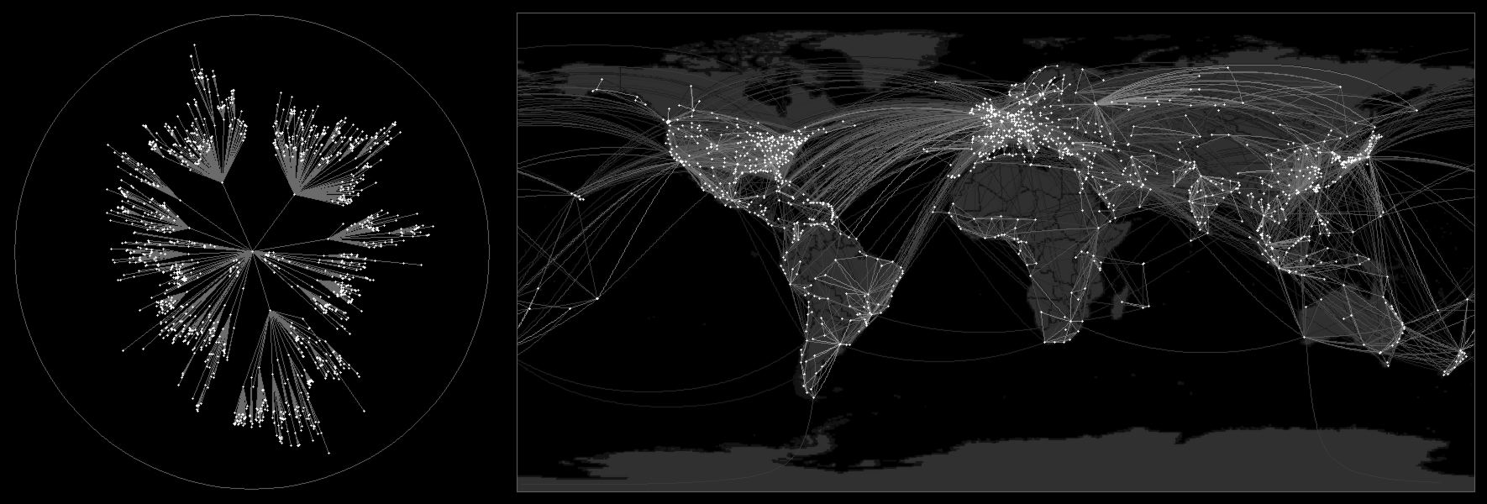
Centrality and contagion spread
Global Epidemic and Mobility modeler (GLEAM) network simulation of the H1N1 2009 virus spread from Mexico to the rest of the world based on flights between airports
http://www.gleamviz.org/

Slide 16
Acknowledgments
The authors acknowledge funding of the work described here by the EPSRC (Engineering and Physical Sciences research Council of the UK) under Programme Grants EP/I01344X/1 and EP/N017064/1. We also thank all ITRC/MISTRAL colleagues for their continuing help in developing and adapting the modelling approach presented here.
Contact:
raghav.pant@ouce.ox.ac.uk
Website:
www.itrc.org.uk
Any questions?

